Slide 1


http://www.comp.nus.edu.sg/~cs2100/
Lecture #18
MSI Components

Slide 2
Questions?
Ask at
https://sets.netlify.app/module/676ca3a07d7f5ffc1741dc65
OR
Scan and ask your questions here! (May be obscured in some slides)

Slide 3
Lecture #18: MSI Components
Introduction
Decoders
Encoders
Demultiplexers
Multiplexers

Slide 4
1. Introduction (1/2)
An integrated circuit (referred to as an IC, a chip or a microchip) is a set of electronic circuits on one small flat piece (or ‘chip’) of semiconductor material.
Scale of integration: the number of components fitted into a standard size IC
Name | Signification | Year | #transistors | #logic gates
SSI | Small-scale integration | 1964 | 1 to 10 | 1 to 12
MSI | Medium-scale integration | 1968 | 10 to 500 | 13 to 99
LSI | Large-scale integration | 1971 | 500 to 20000 | 100 to 9999
VLSI | Very large-scale integration | 1980 | 20k to 1m | 10k to 99999
ULSI | Ultra-large-scale integration | 1984 | 1m and more | 100k and more

Slide 5
1. Introduction (2/2)
Four common and useful MSI circuits:
Decoder
Demultiplexer
Encoder
Multiplexer
Block diagrams of the above MSI circuits:
decoder
encoder
code
entity
entity
code
mux
data
data
demux
output
input
select
select

Slide 6
2. Decoders (1/5)
Codes are frequently used to represent entities, eg: your name is a code to denote yourself (an entity!)
These codes can be identified (or decoded) using a decoder. Given a code, identify the entity.
Convert binary information from n input lines to (a maximum of) 2^{n} output lines.
Known as n-to-m-line decoder, or simply n:m or n×m decoder (m ≤ 2^{n}).
May be used to generate 2^{n} minterms of n input variables.

Slide 7



Decoding – the inefficient way
0
0
0
0
0
1
0
0
0
1
2
3
4
5
6
7

Slide 8
Decoding – the better way
1
0
1
Some device
0
1
2
3
4
5
6
7

Slide 9
2. Decoders (2/5)
Example: If codes 00, 01, 10, 11 are used to identify four light bulbs, we may use a 2-bit decoder.
2x4
DEC
F₀ F₁ F₂ F₃
Bulb 0
Bulb 1
Bulb 2
Bulb 3
2-bit code
X
Y
This is a 2×4 decoder which selects an output line based on the 2-bit code supplied.
Truth table:
X | Y | F₀ | F₁ | F₂ | F₃
0 | 0 | 1 | 0 | 0 | 0
0 | 1 | 0 | 1 | 0 | 0
1 | 0 | 0 | 0 | 1 | 0
1 | 1 | 0 | 0 | 0 | 1

Slide 10
2. Decoders (3/5)
X | Y | F₀ | F₁ | F₂ | F₃
0 | 0 | 1 | 0 | 0 | 0
0 | 1 | 0 | 1 | 0 | 0
1 | 0 | 0 | 0 | 1 | 0
1 | 1 | 0 | 0 | 0 | 1
From truth table, circuit for 2×4 decoder is:
Note: Each output is a minterm (X'⋅Y', X'⋅Y, X⋅Y' or X⋅Y) of a 2-variable function
F₀ = X'⋅Y'
F₁ = X'⋅Y
F₂ = X⋅Y'
F₃ = X⋅Y
X
Y

Slide 11
2. Decoders (4/5)
Design a 3×8 decoder.
F₀ = x'⋅y'⋅z'
x | y | z | F₀ | F₁ | F₂ | F₃ | F₄ | F₅ | F₆ | F₇
0 | 0 | 0 | 1 | 0 | 0 | 0 | 0 | 0 | 0 | 0
0 | 0 | 1 | 0 | 1 | 0 | 0 | 0 | 0 | 0 | 0
0 | 1 | 0 | 0 | 0 | 1 | 0 | 0 | 0 | 0 | 0
0 | 1 | 1 | 0 | 0 | 0 | 1 | 0 | 0 | 0 | 0
1 | 0 | 0 | 0 | 0 | 0 | 0 | 1 | 0 | 0 | 0
1 | 0 | 1 | 0 | 0 | 0 | 0 | 0 | 1 | 0 | 0
1 | 1 | 0 | 0 | 0 | 0 | 0 | 0 | 0 | 1 | 0
1 | 1 | 1 | 0 | 0 | 0 | 0 | 0 | 0 | 0 | 1
F₁ = x'⋅y'⋅z
F₂ = x'⋅y⋅z'
F₃ = x'⋅y⋅z
F₄ = x⋅y'⋅z'
F₅ = x⋅y'⋅z
F₆ = x⋅y⋅z'
F₇ = x⋅y⋅z
x
y
z

Slide 12
2. Decoders (5/5)
In general, for an n-bit code, a decoder could select up to 2^{n} lines:
n-bit
code
n to 2^{n}
decoder
up to 2^{n}
output lines
:
:

Slide 13
2. Decoders: Implementing Functions (1/3)
A Boolean function, in sum-of-minterms form a
decoder to generate the minterms, and
an OR gate to form the sum.
Any combinational circuit with n inputs and m outputs can be implemented with an n:2^{n} decoder with m OR gates.
Good when circuit has many outputs, and each function is expressed with a few minterms.

Slide 14
2. Decoders: Implementing Functions (2/3)
Example: Full adder
S(x, y, z) = Σ m(1,2,4,7)
C(x, y, z) = Σ m(3,5,6,7)
3x8
DEC
0
1
2
3
4
5
6
7
S
x
S₂
S₁
S₀
y
z
C

Slide 15
2. Decoders: Implementing Functions (3/3)
S(x, y, z) = Σ m(1,2,4,7)
C(x, y, z) = Σ m(3,5,6,7)
3x8
DEC
1
0
0
0
0
0
0
0
0
1
0
0
0
0
0
0
0
1
2
3
4
5
6
7
0
0
0
0
0
0
0
1
0
1
S
1
0
0
1
x
0
0
0
1
1
1
S₂
S₁
S₀
y
0
0
C
1
z
BRAVO!!!


Slide 16
2. Decoders with Enable (1/2)
Decoders often come with an enable control signal, so that the device is only activated when the enable, E = 1.
Truth table:
F₀ = E⋅X'⋅Y'
E | X | Y | F₀ | F₁ | F₂ | F₃
1 | 0 | 0 | 1 | 0 | 0 | 0
1 | 0 | 1 | 0 | 1 | 0 | 0
1 | 1 | 0 | 0 | 0 | 1 | 0
1 | 1 | 1 | 0 | 0 | 0 | 1
0 | d | d | 0 | 0 | 0 | 0
F₁ = E⋅X'⋅Y
F₂ = E⋅X⋅Y'
F₃ = E⋅X⋅Y
Circuit of a 2×4 decoder with enable:
X
Y
E

Slide 17
2. Decoders with Enable (2/2)
In the previous slide, the decoder has a one-enable control signal, i.e. the decoder is enabled with E=1.
In most MSI decoders, enable signal is zero-enable, usually denoted by E' or Ē. The decoder is enabled when the signal is zero (low).
E | X | Y | F₀ | F₁ | F₂ | F₃
1 | 0 | 0 | 1 | 0 | 0 | 0
1 | 0 | 1 | 0 | 1 | 0 | 0
1 | 1 | 0 | 0 | 0 | 1 | 0
1 | 1 | 1 | 0 | 0 | 0 | 1
0 | d | d | 0 | 0 | 0 | 0
E' | X | Y | F₀ | F₁ | F₂ | F₃
0 | 0 | 0 | 1 | 0 | 0 | 0
0 | 0 | 1 | 0 | 1 | 0 | 0
0 | 1 | 0 | 0 | 0 | 1 | 0
0 | 1 | 1 | 0 | 0 | 0 | 1
1 | d | d | 0 | 0 | 0 | 0
Decoder with 1-enable
Decoder with 0-enable

Slide 18
2. Constructing Larger Decoders (1/4)
Larger decoders can be constructed from smaller ones.
Example: A 3×8 decoder can be built from two 2×4 decoders (with one-enable) and an inverter.
3x8
DEC
F₀ = w'⋅x'⋅y'
F₁ = w'⋅x'⋅y
:
:
F₇ = w⋅x⋅y
0
1
:
:
7
w
x
y
S₂
S₁
S₀
2x4
DEC
w
x
y
0
1
2
3
F₀ = w'⋅x'⋅y'
F₁ = w'⋅x'⋅y
F₂ = w'⋅x⋅y'
F₃ = w'⋅x⋅y
S₁
S₀
E
2x4
DEC
0
1
2
3
F₄ = w⋅x'⋅y'
F₅ = w⋅x'⋅y
F₆ = w⋅x⋅y'
F₇ = w⋅x⋅y
S₁
S₀
E

Slide 19
2. Constructing Larger Decoders (2/4)
3x8
Dec
F₀ = w'⋅x'⋅y'
F₁ = w'⋅x'⋅y
:
:
F₇ = w⋅x⋅y
0
1
:
:
7
w
x
y
S₂
S₁
S₀
BRAVO!!!
0
0
0
0
0
1
1
1
0
2x4
Dec
1
0
0
0
0
1
0
0
0
0
0
0
w
x
y
0
1
2
3
F₀ = w'⋅x'⋅y'
F₁ = w'⋅x'⋅y
F₂ = w'⋅x⋅y'
F₃ = w'⋅x⋅y
S₁
S₀
E
1
1
0
2x4
Dec
0
0
0
0
0
0
0
0
0
0
1
0
0
1
2
3
F₄ = w⋅x'⋅y'
F₅ = w⋅x'⋅y
F₆ = w⋅x⋅y'
F₇ = w⋅x⋅y
S₁
S₀
E
0
0
1


Slide 20
2. Constructing Larger Decoders (3/4)
Construct a 4×16 decoder from two 3×8 decoders with one-enable and an inverter.
4x16
DEC
w
x
y
z
S₃
S₂
S₁
S₀
0
1
:
:
15
F₀
F₁
:
:
F₁₅
3x8
DEC
w
x
y
z
0
1
:
7
F₀
F₁
:
F₇
S₂
S₁
S₀
E
3x8
DEC
S₂
S₁
S₀
0
1
:
7
F₈
F₉
:
F₁₅
E
Note: The input w and its complement w' are used to select either one of the two smaller decoders.

Slide 21
2. Constructing Larger Decoders (4/4)
Exercise: What modifications should be made to provide an ENABLE input for the 3×8 decoder and the 4×16 decoder created in the previous two examples?
Exercise: How to construct a 4×16 decoder using five 2×4 decoders with enable?
Decoders may also have zero-enable and/or negated outputs. (See next two slides.)
Normal outputs = active high outputs
Negated outputs = active low outputs

Slide 22
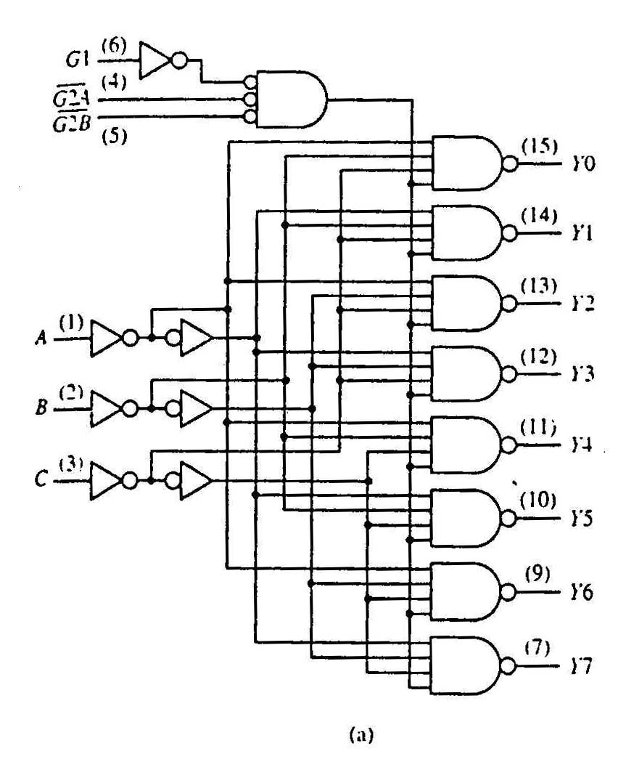
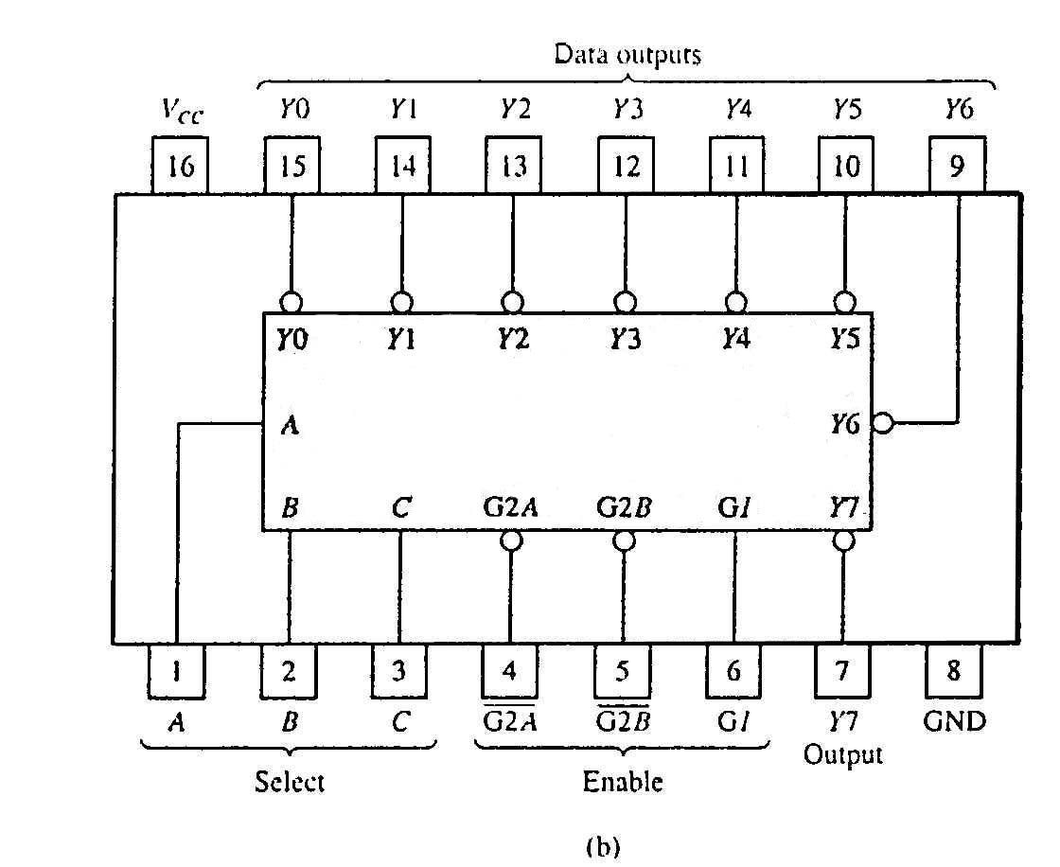
2. Standard MSI Decoder (1/2)
74138 (3-to-8 decoder)
74138 decoder module.
(a) Logic circuit.
(b) Package pin configuration.

Slide 23
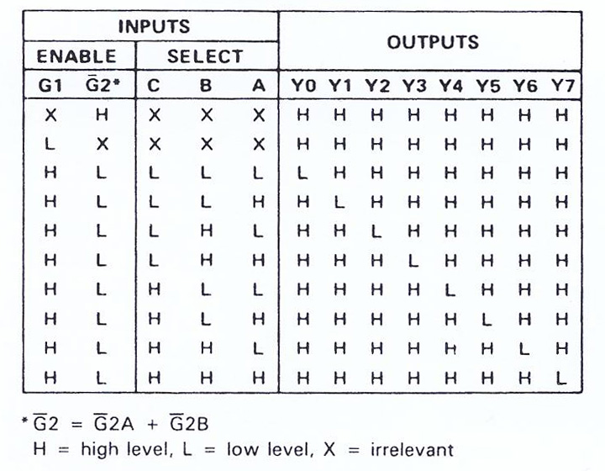
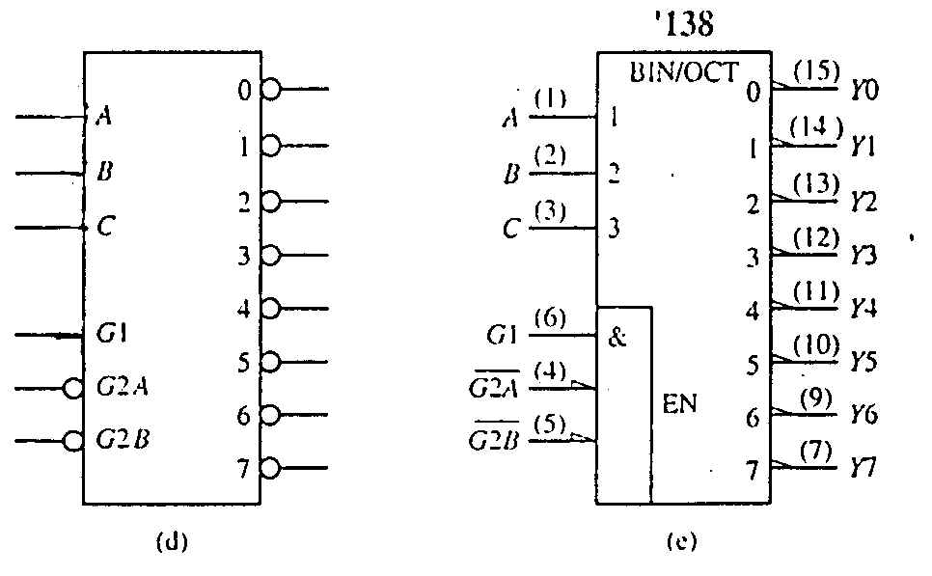
2. Standard MSI Decoder (2/2)
74138 decoder module.
(c) Function table.
(c)
74138 decoder module.
(d) Generic symbol.
(e) IEEE standard logic symbol.
Source:The Data Book Volume 2, Texas Instruments Inc.,1985

Slide 24
2. Decoders: Implementing Functions Revisit (1/2)
Example: Implement the following function using a 3×8 decoder and an appropriate logic gate
f(Q,X,P) = ∑ m(0,1,4,6,7) = ∏ M(2,3,5)
We may implement the function in several ways:
Using a decoder with active-high outputs with an OR gate: f(Q,X,P) = m₀ + m₁ + m₄ + m₆ + m₇
Using a decoder with active-low outputs with a NAND gate: f(Q,X,P) = (m₀' ⋅ m₁' ⋅ m₄' ⋅ m₆' ⋅ m₇' )'
Using a decoder with active-high outputs with a NOR gate: f(Q,X,P) = (m₂ + m₃ + m₅ )' [ = M₂ ⋅ M₃ ⋅ M₅ ]
Using a decoder with active-low outputs with an AND gate: f(Q,X,P) = m₂' ⋅ m₃' ⋅ m₅'

Slide 25
2. Decoders: Implementing Functions Revisit (2/2)
f(Q,X,P) = Σm(0,1,4,6,7) = ∏ M(2,3,5)
0
1
2
3
4
5
6
7
0
1
2
3
4
5
6
7
3x8
Dec
3x8
Dec
Q
X
P
A
B
C
f(Q,X,P)
Q
X
P
A
B
C
f(Q,X,P)
(m0'·m1'·m4'·m6'·m7)'
=m0+m1+m4+m6+m7
(a) Active-high decoder with OR gate.
(b) Active-low decoder with NAND gate.
0
1
2
3
4
5
6
7
0
1
2
3
4
5
6
7
3x8
Dec
3x8
Dec
f(Q,X,P)
f(Q,X,P)
Q
X
P
A
B
C
Q
X
P
A
B
C
(m2+m3+m5)'
= m2'·m3'·m5'
= M2·M3·M5
m2'·m3'·m5'
= M2·M3·M5
(c) Active-high decoder with NOR gate.
(d) Active-low decoder with AND gate.

Slide 26
Reading
Reducing Decoders
Read up DLD pages 136 – 140.

Slide 27
3. Encoders (1/4)
Encoding is the converse of decoding.
Given a set of input lines, of which exactly one is high and the rest are low, the encoder provides a code that corresponds to that high input line.
Contains 2^{n} (or fewer) input lines and n output lines.
Implemented with OR gates.
Example:
F₀
D₀
Select via switches
F₁
4-to-2 Encoder
F₂
2-bits code
F₃
D₁

Slide 28


Encoding – the inefficient way
0
1
2
3
4
5
6
7
0
0
0
0
0
1
0
0

Slide 29
Encoding – the better way
0
1
2
3
4
5
6
7
Some device
1
0
1

Slide 30
3. Encoders (2/4)
Truth table:
With K-map, we obtain:
D₀ = F1 + F3 D₁ = F2 + F3
Circuit:
F₀
F₁
D₀
F₂
F₃
D₁
Simple 4-to-2 encoder


Slide 31
3. Encoders (3/4)
Example: 8-to-3 encoder.
At any one time, only one input line of an encoder has a value of 1 (high), the rest are zeroes (low).
To allow for more than one input line to carry a 1,we need priority encoder.

Slide 32
3. Encoders (4/4)
Example: 8-to-3 encoder.
D₀
D₁
D₂
D₃
D₄
D₅
D₆
D₇
x = D₄ + D₅ + D₆ + D₇
y = D₂ + D₃ + D₆ + D₇
z = D₁ + D₃ + D₅ + D₇
An 8-to-3 encoder
Exercise: Can you design a 2^{n}-to-n encoder without using K-map?

Slide 33
3. Priority Encoders (1/2)
A priority encoder is one with priority
If two or more inputs or equal to 1, the input with the highest priority takes precedence.
If all inputs are 0, this input combination is considered invalid.
Example of a 4-to-2 priority encoder:
Inputs |  |  |  | Outputs
D₀ | D₁ | D₂ | D₃ | f | g | V
0 | 0 | 0 | 0 | X | X | 0
1 | 0 | 0 | 0 | 0 | 0 | 1
X | 1 | 0 | 0 | 0 | 1 | 1
X | X | 1 | 0 | 1 | 0 | 1
X | X | X | 1 | 1 | 1 | 1

Slide 34
3. Priority Encoders (2/2)
Understanding “compact” function table
Inputs |  |  |  | Outputs
D₀ | D₁ | D₂ | D₃ | f | g | V
0 | 0 | 0 | 0 | X | X | 0
1 | 0 | 0 | 0 | 0 | 0 | 1
X | 1 | 0 | 0 | 0 | 1 | 1
X | X | 1 | 0 | 1 | 0 | 1
X | X | X | 1 | 1 | 1 | 1
Inputs |  |  |  | Outputs
D₀ | D₁ | D₂ | D₃ | f | g | V
0 | 0 | 0 | 0 | X | X | 0
1 | 0 | 0 | 0 | 0 | 0 | 1
0 | 1 | 0 | 0 | 0 | 1 | 1
1 | 1 | 0 | 0 | 0 | 1 | 1
0 | 0 | 1 | 0 | 1 | 0 | 1
0 | 1 | 1 | 0 | 1 | 0 | 1
1 | 0 | 1 | 0 | 1 | 0 | 1
1 | 1 | 1 | 0 | 1 | 0 | 1
0 | 0 | 0 | 1 | 1 | 1 | 1
0 | 0 | 1 | 1 | 1 | 1 | 1
0 | 1 | 0 | 1 | 1 | 1 | 1
0 | 1 | 1 | 1 | 1 | 1 | 1
1 | 0 | 0 | 1 | 1 | 1 | 1
1 | 0 | 1 | 1 | 1 | 1 | 1
1 | 1 | 0 | 1 | 1 | 1 | 1
1 | 1 | 1 | 1 | 1 | 1 | 1
Exercise: Obtain the simplified expressions for f, g and V.


Slide 35
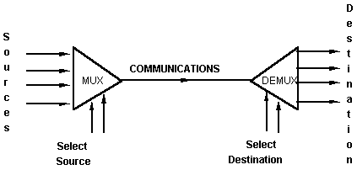
Multiplexers and Demultiplexers
An application:
Helps share a single communication line among a number of devices.
At any time, only one source and one destination can use the communication line.

Slide 36
4. Demultiplexers (1/2)
Given an input line and a set of selection lines, a demultiplexer directs data from the input to one selected output line.
Example: 1-to-4 demultiplexer.
Outputs
Y₀ = D∙S₁'∙S₀'
Y₁ = D∙S₁'∙S₀
Data D
demux
Y₂ = D∙S₁∙S₀'
Y₃ = D∙S₁∙S₀
S₁ S₀
select

Slide 37
4. Demultiplexers (2/2)
It turns out that the demultiplexer circuit is actually identical to a decoder with enable.
2×4 Decoder
0
1
2
3
Y₀ = ?
D∙S₁'∙S₀'
D∙S₁'∙S₀
D∙S₁∙S₀'
D∙S₁∙S₀
S₁
S₀
A
B
Y₁ = ?
Y₂ = ?
E
Y₃ = ?
Outputs
Y₀ = D∙S₁'∙S₀'
D
Y₁ = D∙S₁'∙S₀
Data D
demux
Y₂ = D∙S₁∙S₀'
Y₃ = D∙S₁∙S₀
S₁ S₀
select


Slide 38
5. Multiplexers (1/4)
A multiplexer is a device that has
A number of input lines
A number of selection lines
One output line
It steers one of 2^{n} inputs to a single output line, using n selection lines. Also known as a data selector.
2^{n}:1
Multiplexer
inputs
output
:
...
select

Slide 39
5. Multiplexers (2/4)
Truth table for a 4-to-1 multiplexer:
Inputs
Inputs
I₀
0
1
2
3
I₀
I₁
4:1
MUX
I₁
4:1mux
I₂
Y
I₂
Y
Output
I₃
I₃
S₁ S₀
S₁ S₀
select
select

Slide 40
5. Multiplexers (3/4)
Output of multiplexer is
“sum of the (product of data lines and selection lines)”
Example: Output of a 4-to-1 multiplexer is:
Y = ?
I₀∙(S₁'∙S₀') + I₁∙(S₁'∙S₀) + I₂∙(S₁∙S₀') + I₃∙(S₁∙S₀)
Note:
Expressing
I₀∙(S₁'∙S₀') + I₁∙(S₁'∙S₀) + I₂∙(S₁∙S₀') + I₃∙(S₁∙S₀)
in minterms notation, it is equal to
I₀∙m₀ + I₁∙m₁ + I₂∙m₂ + I₃∙m₃
This is useful later (eg: slide 45).

Slide 41
5. Multiplexers (4/4)
A 2^{n}-to-1-line multiplexer, or simply 2^{n}:1 MUX, is made from an n:2^{n} decoder by adding to it 2^{n} input lines, one to each AND gate.
A 4:1 multiplexer circuit:
I₀
I₀
I₁
I₁
Y
Y
I₂
I₂
I₃
I₃
0 1 2 3
2-to-4 Decoder
S₁
S₀
S₁
S₀

Slide 42
5. Multiplexer IC Package
Some IC packages have a few multiplexers in each package (chip). The selection and enable inputs are common to all multiplexers within the package.
A₀
A₁
A₂
A₃
Y₀
Y₁
Y₂
Y₃
B₀
B₁
B₂
B₃
S
(select)
Quadruple 2:1 multiplexer
E'
(enable)

Slide 43
5. Constructing Larger Multiplexers (1/4)
Larger multiplexers can be constructed from smaller ones.
An 8-to-1 multiplexer can be constructed from smaller multiplexers like this (note placement of selector lines):
I₀
I₁
I₂
I₃
4:1 MUX
2:1 MUX
S₁ S₀
Y
I₄
I₅
I₆
I₇
4:1 MUX
S₂
S₁ S₀

Slide 44
5. Constructing Larger Multiplexers (2/4)
I₀
I₁
I₂
I₃
I₀
I₁
I₂
4:1 MUX
2:1 MUX
I₀
I₁
I₆
S₁ S₀
Y
I₄
I₅
I₆
I₇
4:1 MUX
I₄
I₅
I₆
S₂
S₁ S₀
When S₂S₁S₀ = 000
When S₂S₁S₀ = 001
When S₂S₁S₀ = 110

Slide 45
5. Constructing Larger Multiplexers (3/4)
Another implementation of an 8-to-1 multiplexer using smaller multiplexers:
When
S₂S₁S₀ = 000
I₀
I₁
2:1 MUX
I₀
I₁
S₂S₁S₀ = 101
I₂
I₃
2:1 MUX
I₂
0
S₀
I₃
1
4:1 MUX
I₀
0
S₀
Y
1
I₅
I₄
I₅
2:1 MUX
I₄
I₅
S₂ S₁
0 0
0
S₀
I₆
I₇
2:1 MUX
1 0
1
I₆
I₇
0
S₀
Q: Can we use only 2:1 multiplexers?
1

Slide 46
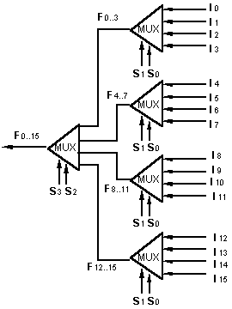
5. Constructing Larger Multiplexers (4/4)
A 16-to-1 multiplexer can be constructed from five 4-to-1 multiplexers:

Slide 47
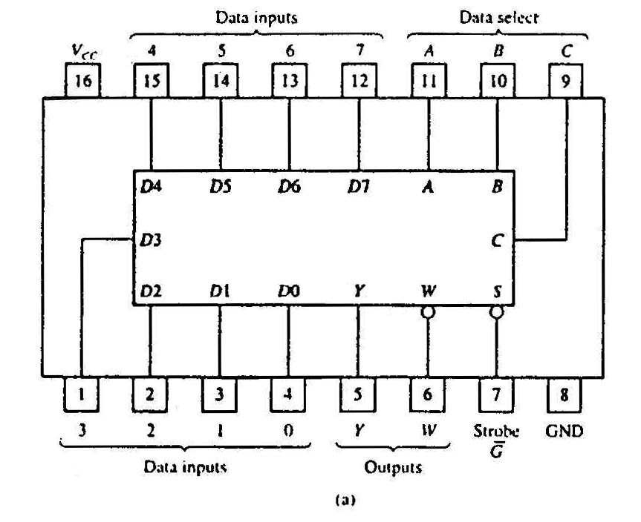
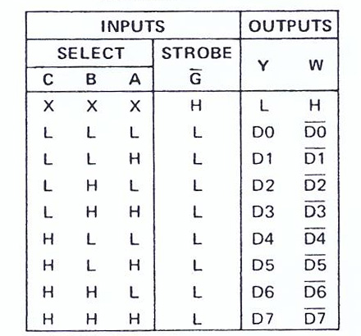
5. Standard MSI Multiplexer (1/2)
(b)
74151A 8-to-1 multiplexer. (a) Package configuration. (b) Function table.

Slide 48
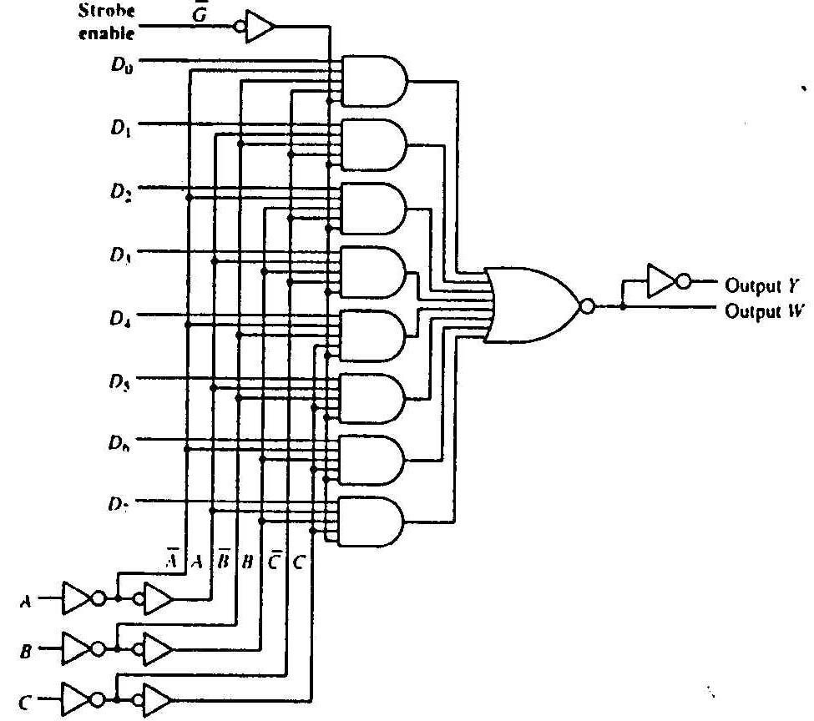
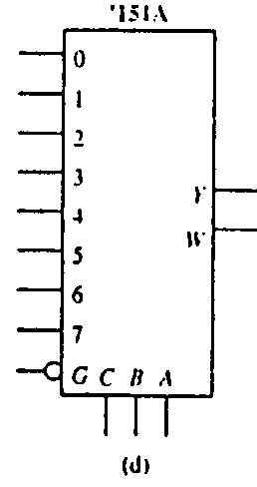
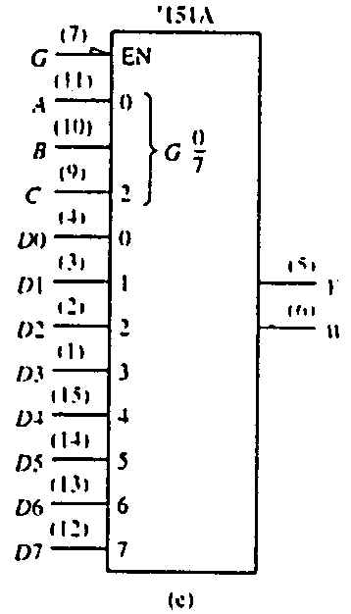
5. Standard MSI Multiplexer (2/2)
(c)
74151A 8-to-1 multiplexer. (c) Logic diagram. (d) Generic logic symbol. (e) IEEE standard logic symbol.
Source: The TTL Data Book Volume 2. Texas Instruments Inc.,1985.

Slide 49
5. Multiplexers: Implementing Functions (1/3)
Boolean functions can be implemented using multiplexers.
A 2^{n}-to-1 multiplexer can implement a Boolean function of n input variables, as follows:
1. Express in sum-of-minterms form.
Example: F(A,B,C) = A'⋅B'⋅C + A'⋅B⋅C + A⋅B'⋅C + A⋅B⋅C' = Σ m(1,3,5,6)
2. Connect n variables to the n selection lines.
3. Put a ‘1’ on a data line if it is a minterm of the function, or ‘0’ otherwise.

Slide 50
5. Multiplexers: Implementing Functions (2/3)
F(A,B,C) = Σ m(1,3,5,6)
This method works because:
Output = I₀⋅m₀ + I₁⋅m₁ + I₂⋅m₂ + I₃⋅m₃ + I₄⋅m₄ + I₅⋅m₅ + I₆⋅m₆ + I₇⋅m₇
Supplying ‘1’ to I₁,I₃,I₅,I₆ , and ‘0’ to the rest:
Output = m₁ + m₃ + m₅ + m₆
0
1
0
1
0
1
1
0
0
1
2
3
4
5
6
7
F
mux
A B C
From slide 34 (4:1 mux)
Expressing
I₀∙(S₁'∙S₀') + I₁∙(S₁'∙S₀) + I₂∙(S₁∙S₀') + I₃∙(S₁∙S₀)
in minterms notation, it is equal to
I₀∙m₀ + I₁∙m₁ + I₂∙m₂ + I₃∙m₃

Slide 51
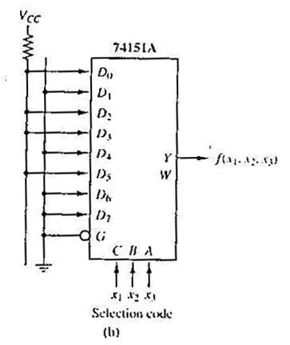
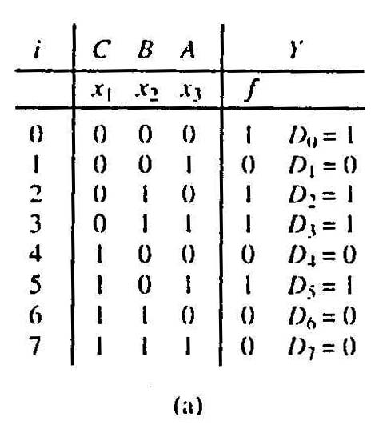
5. Multiplexers: Implementing Functions (3/3)
Example: Use a 74151A to implement f(x₁,x₂,x₃) = Σ m(0,2,3,5)
Realization of f(x₁,x₂,x₃) = ∑m(0,2,3,5).
(a) Truth table.
(b) Implementation with 74151A.

Slide 52
5. Using Smaller Multiplexers (1/6)
Earlier, we saw how a 2^{n}-to-1 multiplexer can be used to implement a Boolean function of n (input) variables.
However, we can use a single smaller 2^{(n-1)}-to-1 multiplexer to implement a Boolean function of n (input) variables.
Example: The function F(A,B,C) = Σ m(1,3,5,6) can be implemented using a 4-to-1 multiplexer (rather than an 8-to-1 multiplexer).

Slide 53
5. Using Smaller Multiplexers (2/6)
Let’s look at this example:
F(A,B,C) = Σ m(0,1,3,6) = A'⋅B'⋅C' + A'⋅B'⋅C + A'⋅B⋅C + A⋅B⋅C'
1
1
0
1
0
0
1
0
0
1
2
3
4
5
6
7
1
C
0
C'
0
1
2
3
F
mux
F
mux
A B C
A B
Note: Two of the variables, A and B, are applied as selection lines of the multiplexer, while the inputs of the multiplexer contain 1, C, 0 and C'.

Slide 54
5. Using Smaller Multiplexers (3/6)
Procedure
1. Express Boolean function in sum-of-minterms form. Example: F(A,B,C) = Σ m(0,1,3,6)
2. Reserve one variable (in our example, we take the least significant one) for input lines of multiplexer, and use the rest for selection lines. Example: C is for input lines; A and B for selection lines.

Slide 55
5. Using Smaller Multiplexers (4/6)
3. Draw the truth table for function, by grouping inputs by selection line values, then determine multiplexer inputs by comparing input line (C) and function (F) for corresponding selection line values.
A | B | C | F | MUX input
0 | 0 | 0 | 1
0 | 0 | 1 | 1
0 | 1 | 0 | 0
0 | 1 | 1 | 1
1 | 0 | 0 | 0
1 | 0 | 1 | 0
1 | 1 | 0 | 1
1 | 1 | 1 | 0
1
C
0
C'
1
0
0
1
2
3
C
F
mux
A B


Slide 56
5. Using Smaller Multiplexers (5/6)
Alternative: What if we use A for input lines, and B, C for selector lines?
A' (when BC = 00)
A' (when BC = 01)
A (when BC = 10)
A
?
?
?
?
0
1
2
3
0
1
2
3
F
A' (when BC = 11)
F
mux
mux
B C
B C


Slide 57
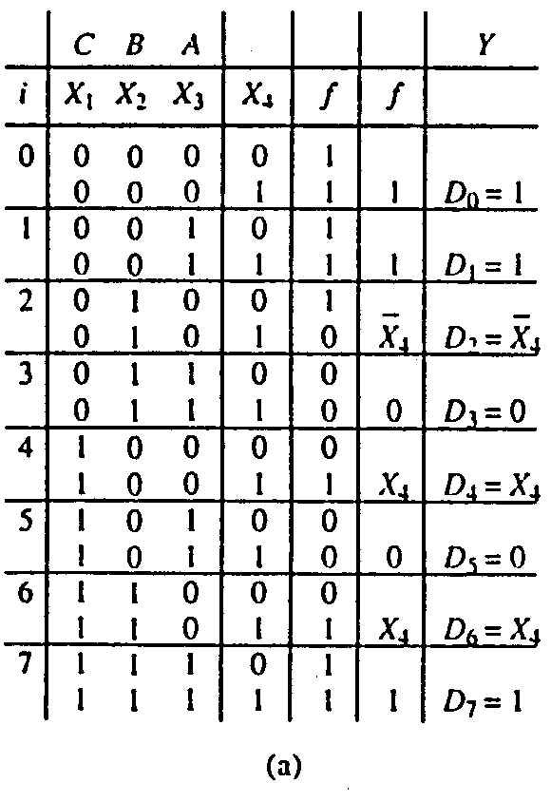
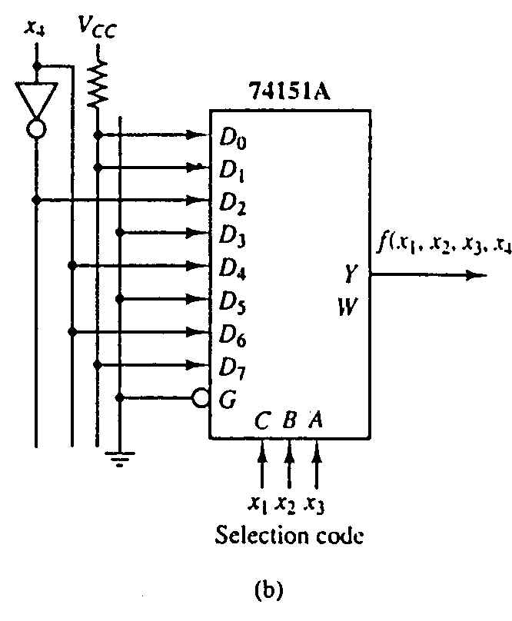
5. Using Smaller Multiplexers (6/6)
Example: Implement the function below with 74151A:
f(x₁,x₂,x₃,x₄) = Σ m(0,1,2,3,4,9,13,14,15)

Slide 58
Peeking Ahead
Address
Input data
Lines
Lines
8 lines
11 10
0 – 9
0–1023
DATA (8)
ADRS (10)
CS
RW
(8)
2x4 decoder
1K x 8
S₀
S₁
0
1
2
3
1024 – 2047
DATA (8)
ADRS (10)
CS
RW
(8)
1K x 8
2048 – 3071
Read/write
DATA (8)
ADRS (10)
CS
RW
(8)
1K x 8
3072 – 4095
DATA (8)
ADRS (10)
CS
RW
(8)
1K x 8
Output data

Slide 59
End of File

